Slide 1

Research Integrity
Scientific misconduct , falsification of data, fabrication of data , plagiarism,
unethical treatment of research subject & failure to disclose conflicts of interest.
Case study : Chernobyl

Slide 2

Meet the team
Anirban Sarkar
2110060
Shafayetul Huda Sadi
2110057
Fardin Shahriar Chowdhury
2110058
Shrayas Chakma
2110061
Md. Ashikur Rahman
2110059

Slide 3
Research Integrity
The ethical and moral principles that guide the conduct of research.
Involves maintaining the highest standards of honesty, transparency, and accuracy throughout all stages of the research process.
Key components:
Honesty and Truthfulness
Transparency
Accountability
Collaboration and credit

Slide 4
Andrew Wakefield & MMR vaccine
Issues with Research Integrity:
Small Sample Size
Misleading Interpretation
Undisclosed Conflicts of Interest
Consequences
Public Panic
Loss of trust
Retraction and Disbarment

Slide 5
Falsification of Data
deliberate manipulation, alteration, or fabrication of research data
undermines the credibility of scientific and academic work and violates the fundamental principles of research integrity
Key components:
Fabrication and manipulation
Selective reporting
Image and visual data manipulation
Inadequate methodology reporting

Slide 6
The Theranos Scandal
Issues with Research Integrity:
Falsified test result
Deceptive practice
Consequences:
Criminal charges
Civil lawsuit
Financial collapse

Slide 7
Fabrication of Data
the deliberate creation of false or fictional data points, results, or information that were never actually collected or observed in a research study
making up data to support a particular hypothesis, conclusion, or narrative, even though the data is entirely imaginary
Key components:
Creation of false data
Deception
Misrepresentation
Supporting a desired outcome

Slide 8
Jan Hendrik Schön's Semiconductor Research
Issues :
Fabricated data
Plagiarism
Exaggerated claims
Consequences
Loss of reputation
Retraction
Professional repercussion

Slide 9
Plagiarism
Using someone else's ideas, words, or creative work without proper attribution or permission and presenting it as one's own
Involves copying, paraphrasing, or closely imitating another person's work and not acknowledging the original source
Key components:
Use of Someone Else's Work
Presentation as One's Own
Intellectual property violation

Slide 10
The case of Fareed Zakaria
Unattributed Borrowing of Text
Lack of Originality
Ethical breach
Consequences:
Damage to Reputation:
Professional Repercussions
Impact on Trust

Slide 11
Failure to disclose conflict of interest
The failure of an individual to openly and transparently reveal any personal, financial, or professional relationships or interests
Occurs when someone's personal interests might compromise their ability to make impartial and unbiased decisions
Key components:
Undisclosed Interests
Ethical breach
Transparency and Accountability
Legal and Regulatory Implications

Slide 12
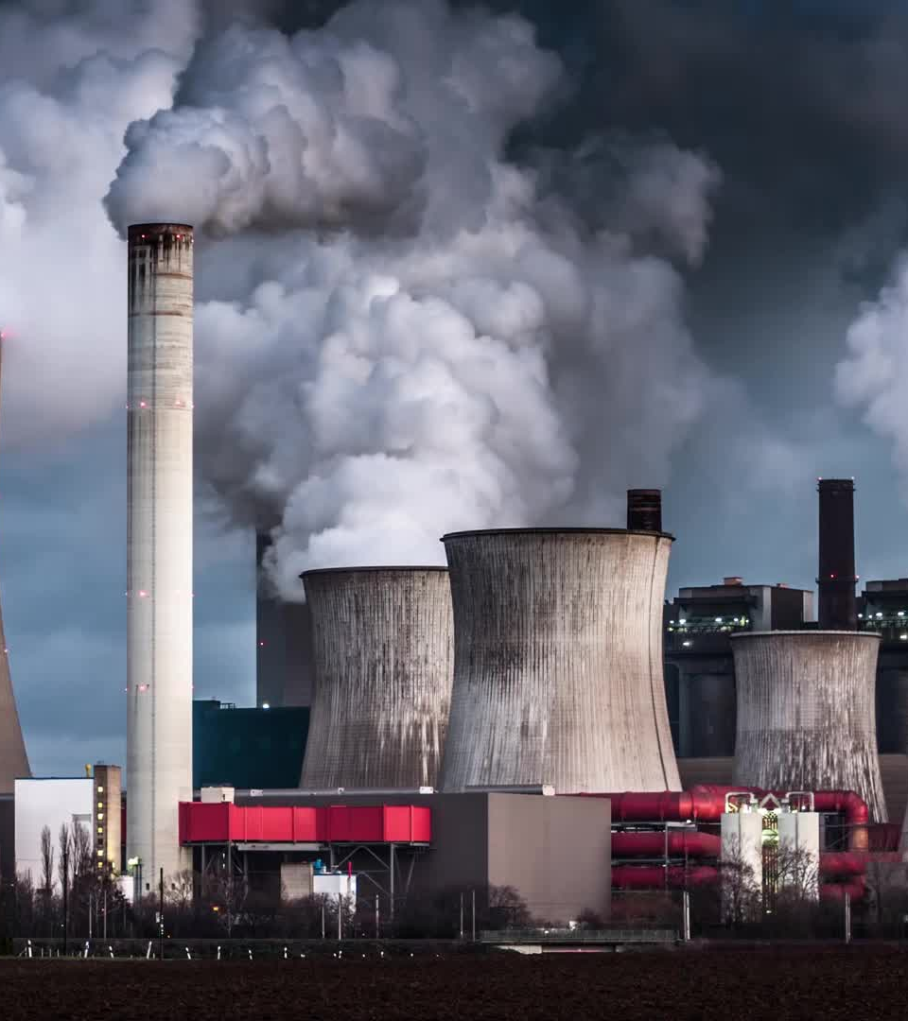

Case Study
Chernobyl Nuclear Plant Disaster

Slide 13
Chernobyl Nuclear plant
Situated near the abandoned city of Pripyat , Northern Ukraine near the Belarus-Ukraine Border.
4 RBMK reactors, each had a capacity to generate 1000 MW of electricity.
Was powered by its own generation.
2 more RBMK reactors are still incomplete.
Was put on permanent shut down in 2000

Slide 14
Chernobyl Catastrophic Disaster
26 Apr. 1986
(Early Morning): The safety test began , control rods were withdrawn from the reactor core
26 Apr. 1986
(Midnight): The test was delayed due to a regional power demand. But the operators were struggling to control the reactor.
26 Apr. 1986
(Late Night): The emergency shutdown procedure led to an unexpected increase in reactor power. The reactor overheated rapidly, causing a steam explosion that ruptured the reactor vessel.
26 Apr. 1986
(1:23 AM): The explosion blew off the reactor's concrete lid, releasing a plume of highly radioactive material into the atmosphere.
26 Apr. 1986
(Morning): Plant workers and firefighters arrived at the scene to battle the fire and contain the radiation.
Apr.–May 1986
Efforts were made to contain the fire and reduce the spread of radioactive contamination.
May 1986
A concrete sarcophagus was constructed over the damaged reactor to contain the radioactive materials and prevent further release of radioactive particles into the atmosphere.

Slide 15
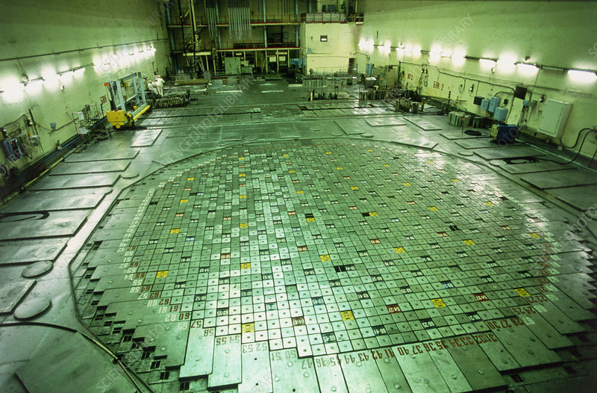
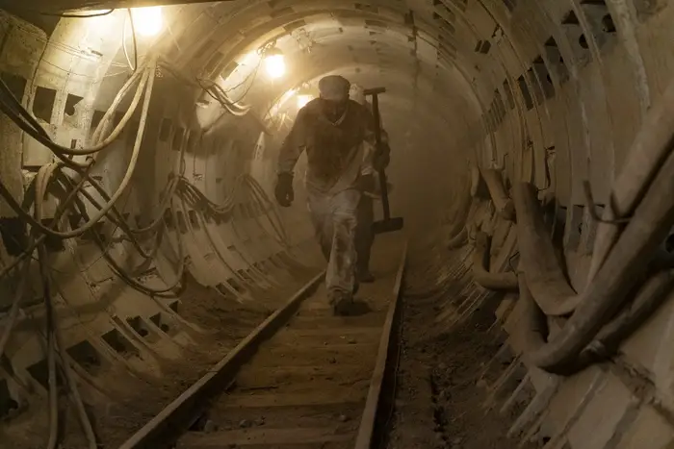
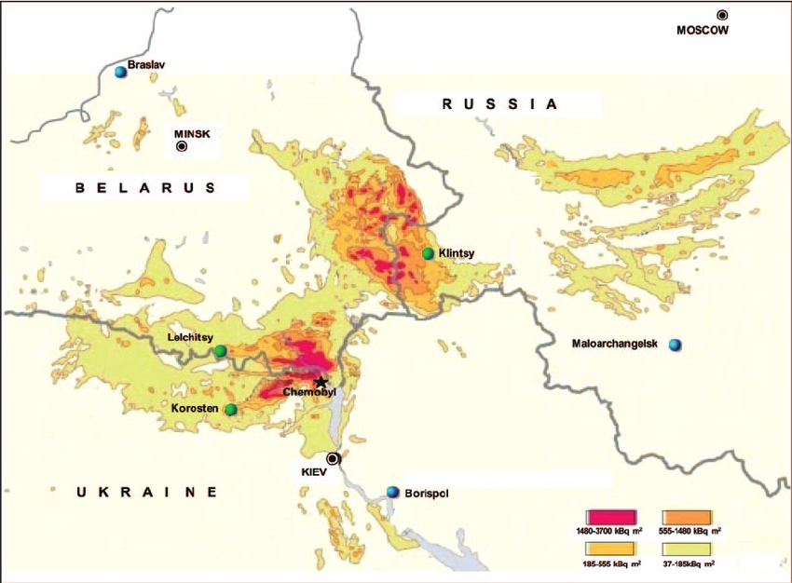
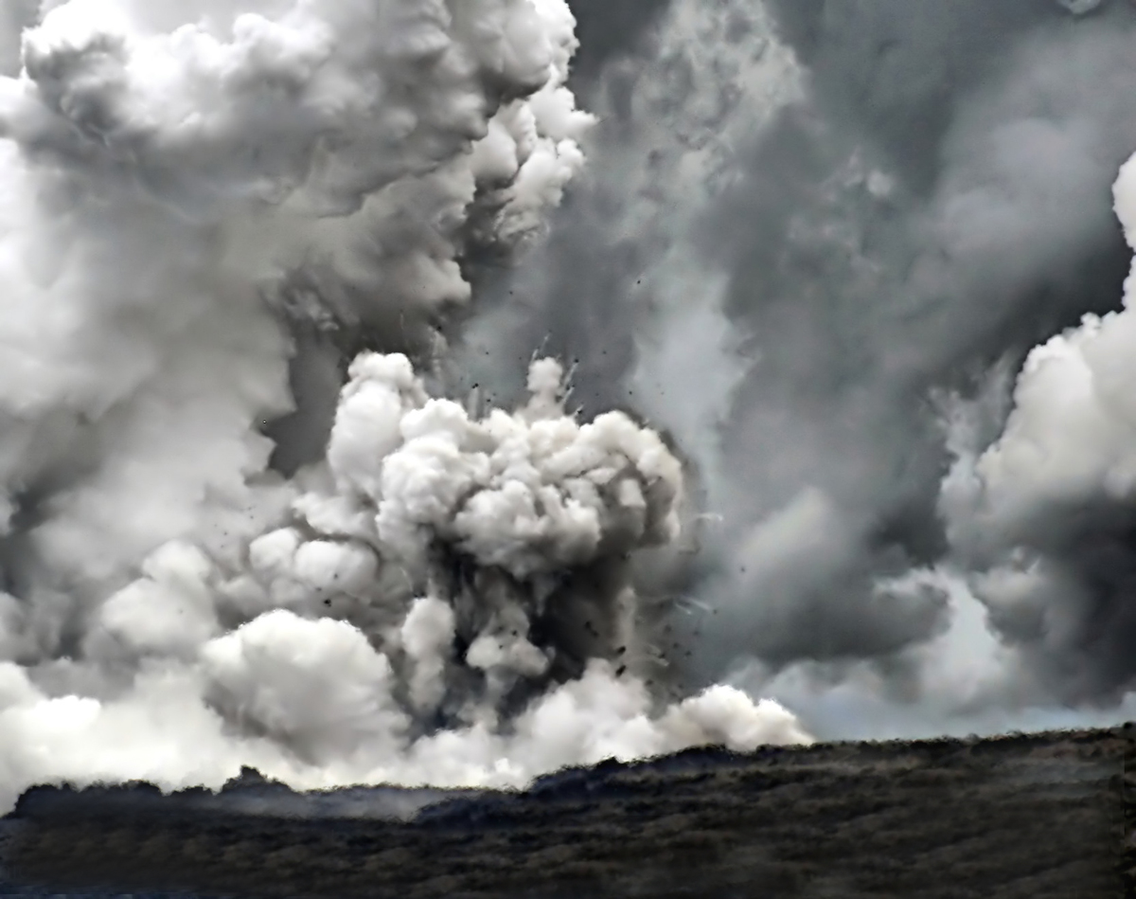
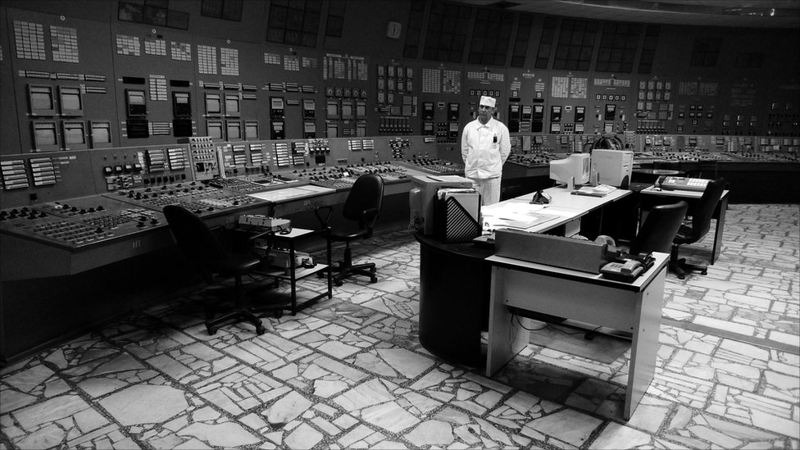
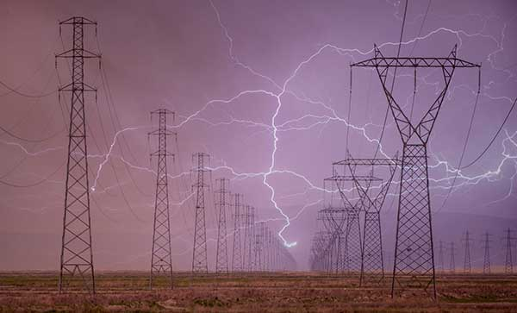
EVENT

Slide 16
Key Reasons to be Highlighted
EVENT

Slide 17
Flaws of reactor design
High positive void coefficient
Graphite moderator
Harder to shut down due to neutron fraction
Unpredictable changes in power
EVENT

Slide 18
Inadequate safety culture
Pressure to meet target
Lack of transparency
Minimal reporting incident
EVENT

Slide 19
Operating Error
Reactor Parameters Mismanagement
Delayed Shutdown
Violating Safety Regulations
EVENT

Slide 20
Power Surge
Unexpected increase in voltage
Opposite effect of graphite tips of control rods
Cascading effect
EVENT

Slide 21
Steam explosion
Steam pressure build up
Rapture of reactor vessel
Release of radioactive material
EVENT

Slide 22
Fire and Fallout
Reactor 4 exploded due to failure
Radioactive particles spread across a wide geographic area
Affected Ukraine , Belarus & Russia
EVENT

Slide 23
EVENT

Slide 24
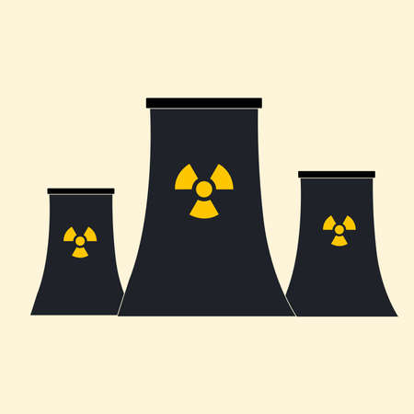
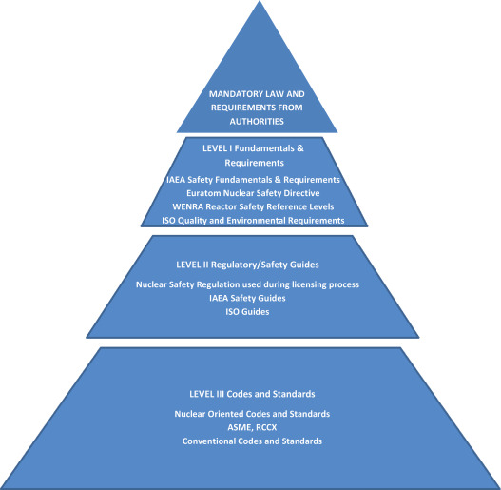


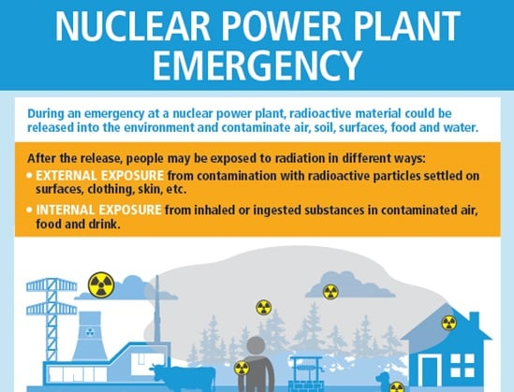
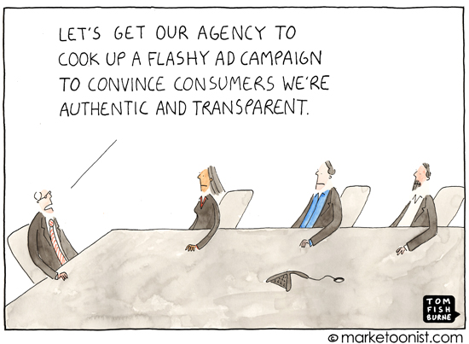
Steps to be taken
to reduce such disasters

Slide 25
Nuclear Reactor Design and Engineering:
Improved reactor design with inherent safety features.
Fail-safe mechanisms for automatic reactor shutdown.
Use of advanced materials and technologies for better safety.

Slide 26
Regulatory Oversight and Safety Standards:
Stringent enforcement of safety regulations and standards.
Regular review and updates of safety protocols.
Regulatory authorities' role in ensuring plant compliance.

Slide 27
Operator Training and Safety Culture:
Comprehensive training for reactor operators.
Conducting drills and simulations for emergency preparedness.
Fostering a strong safety culture within nuclear organizations.

Slide 28
Emergency preparedness
Comprehensive emergency response plans involving local and international cooperation.
Regular drills to test the effectiveness of response plans.
Involvement of public and local authorities in emergency situations.

Slide 29
Public awareness
Educating the public about nuclear benefits and risks.
Transparent reporting of incidents and lessons learned.
Holding individuals and organizations accountable for safety lapses.

Slide 30

Questions

Slide 31
Thank you

